Slide 1

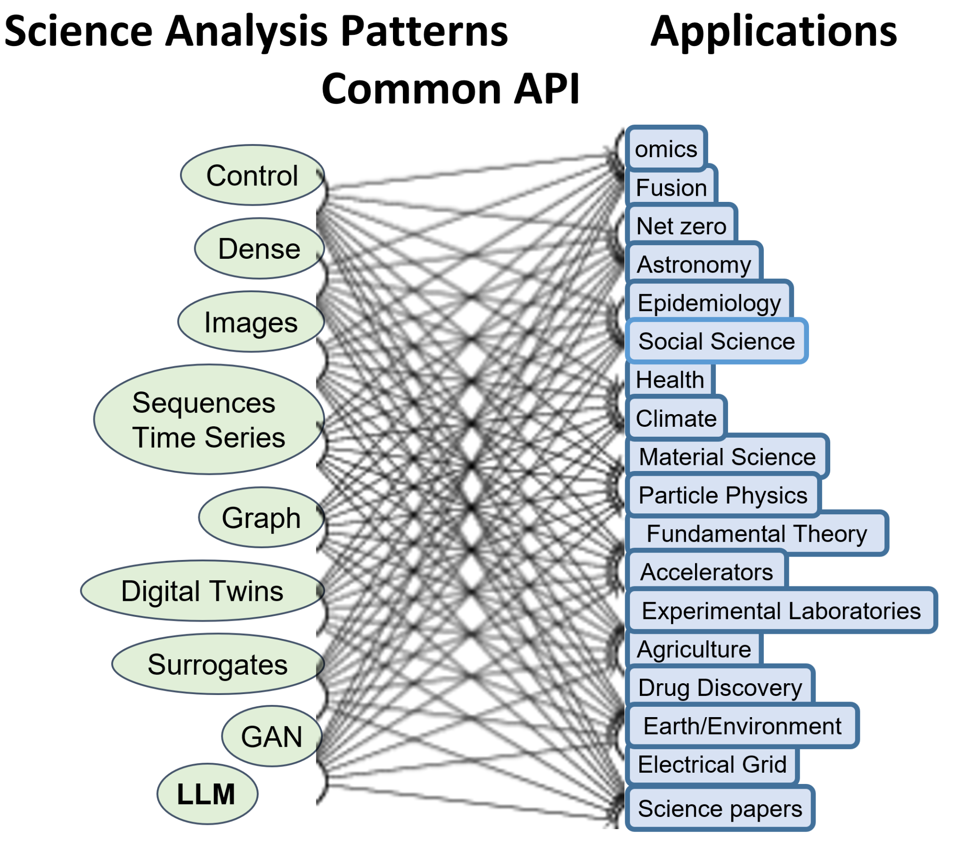

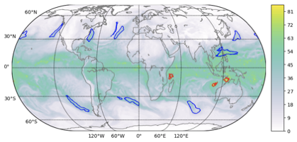
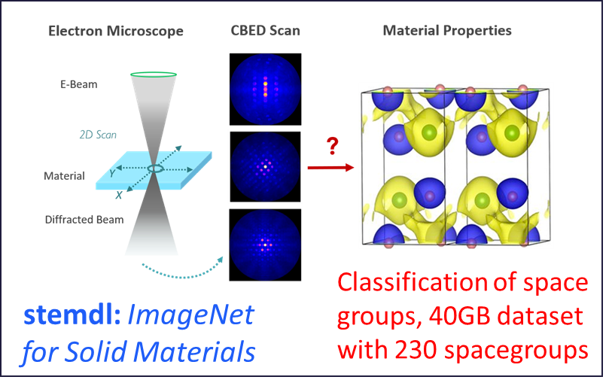
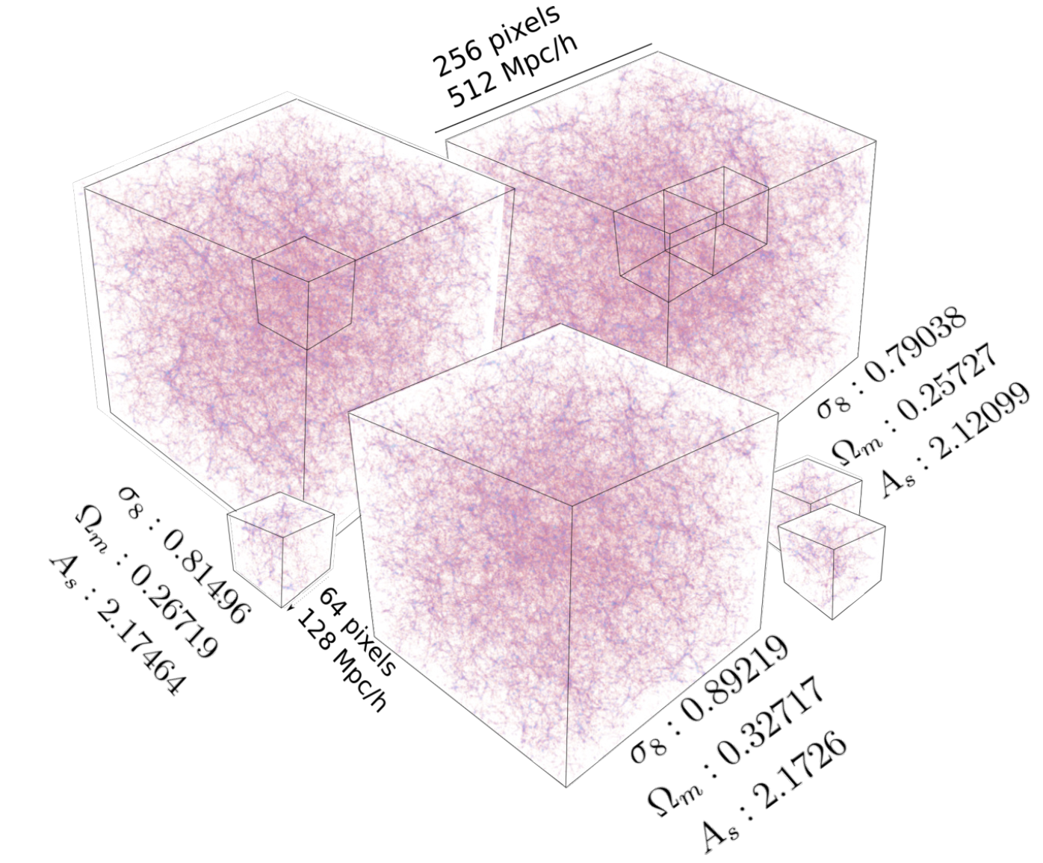
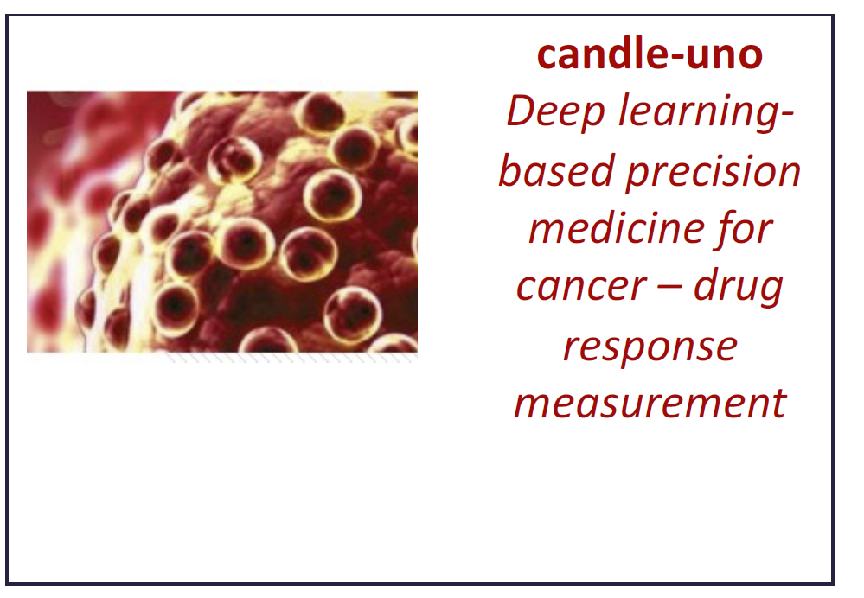

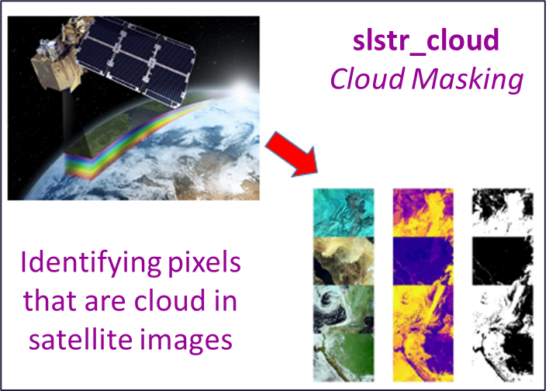
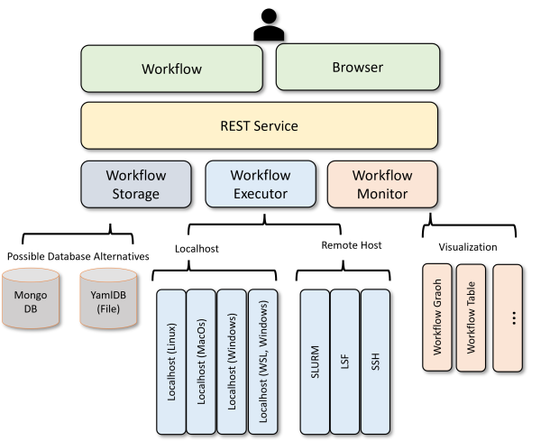
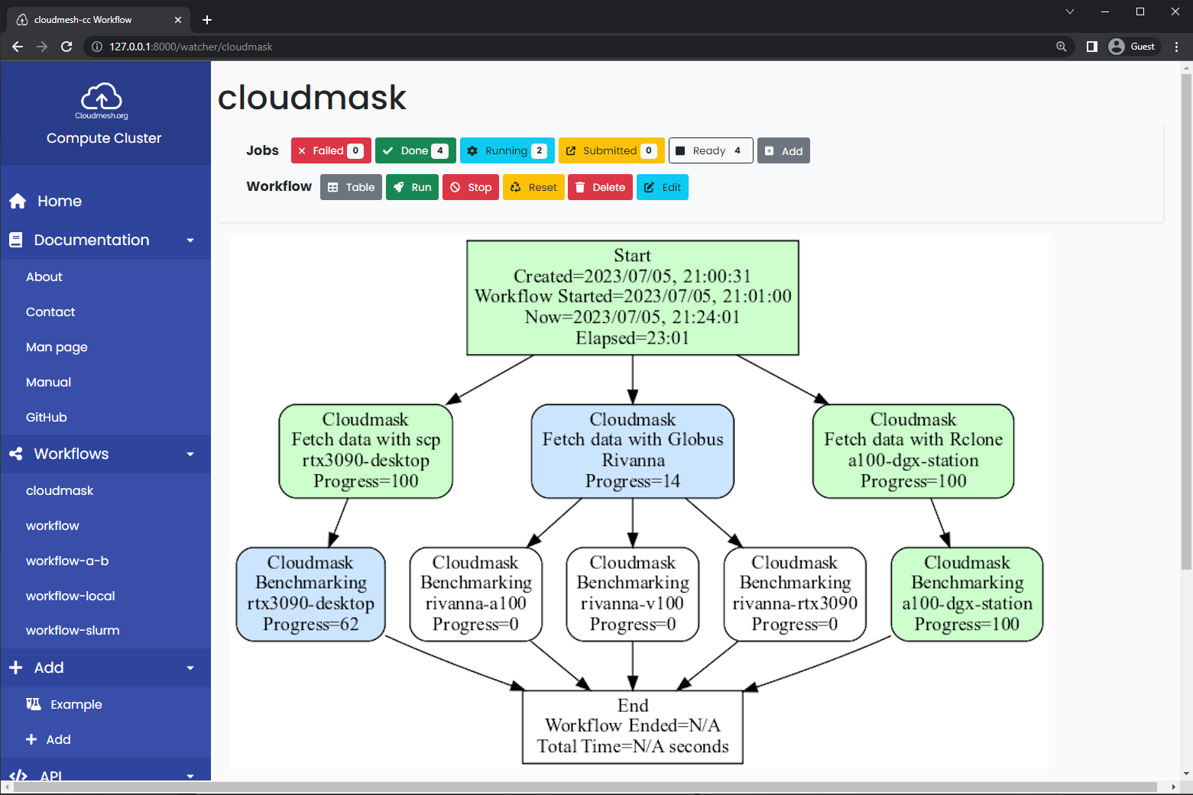
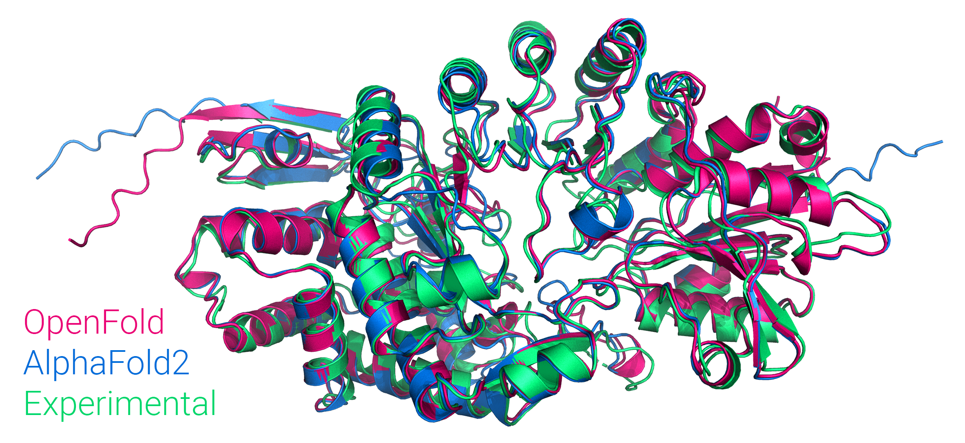
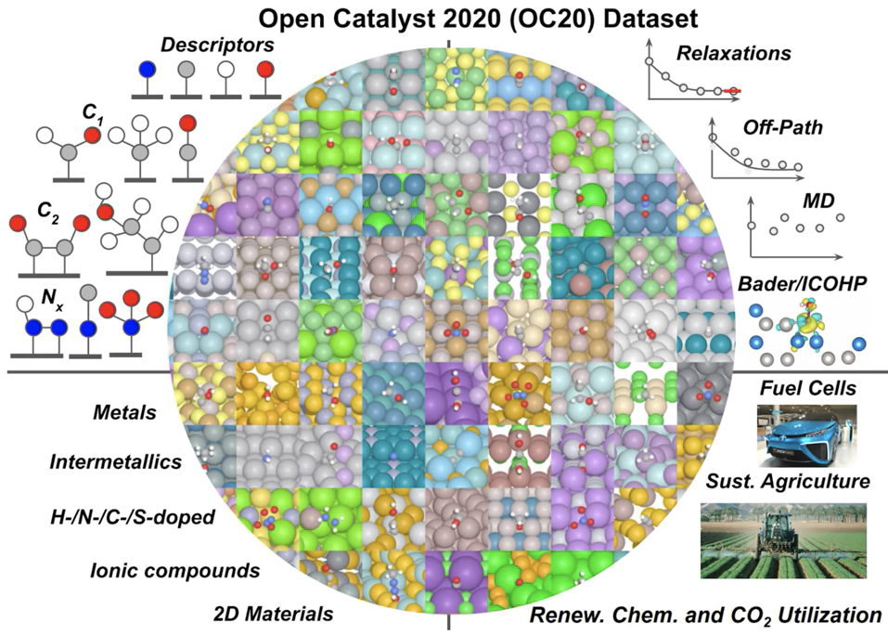
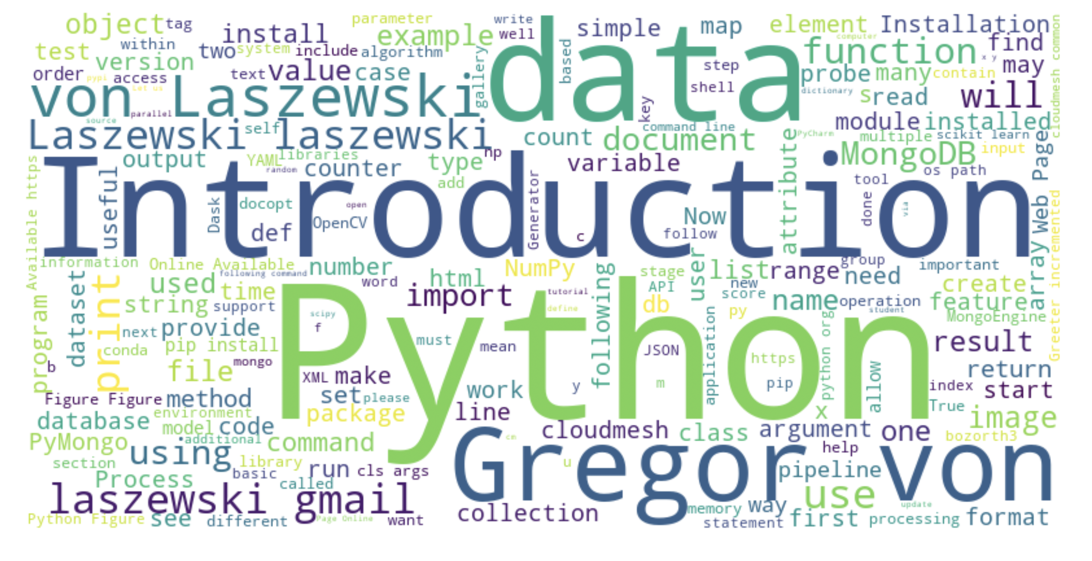
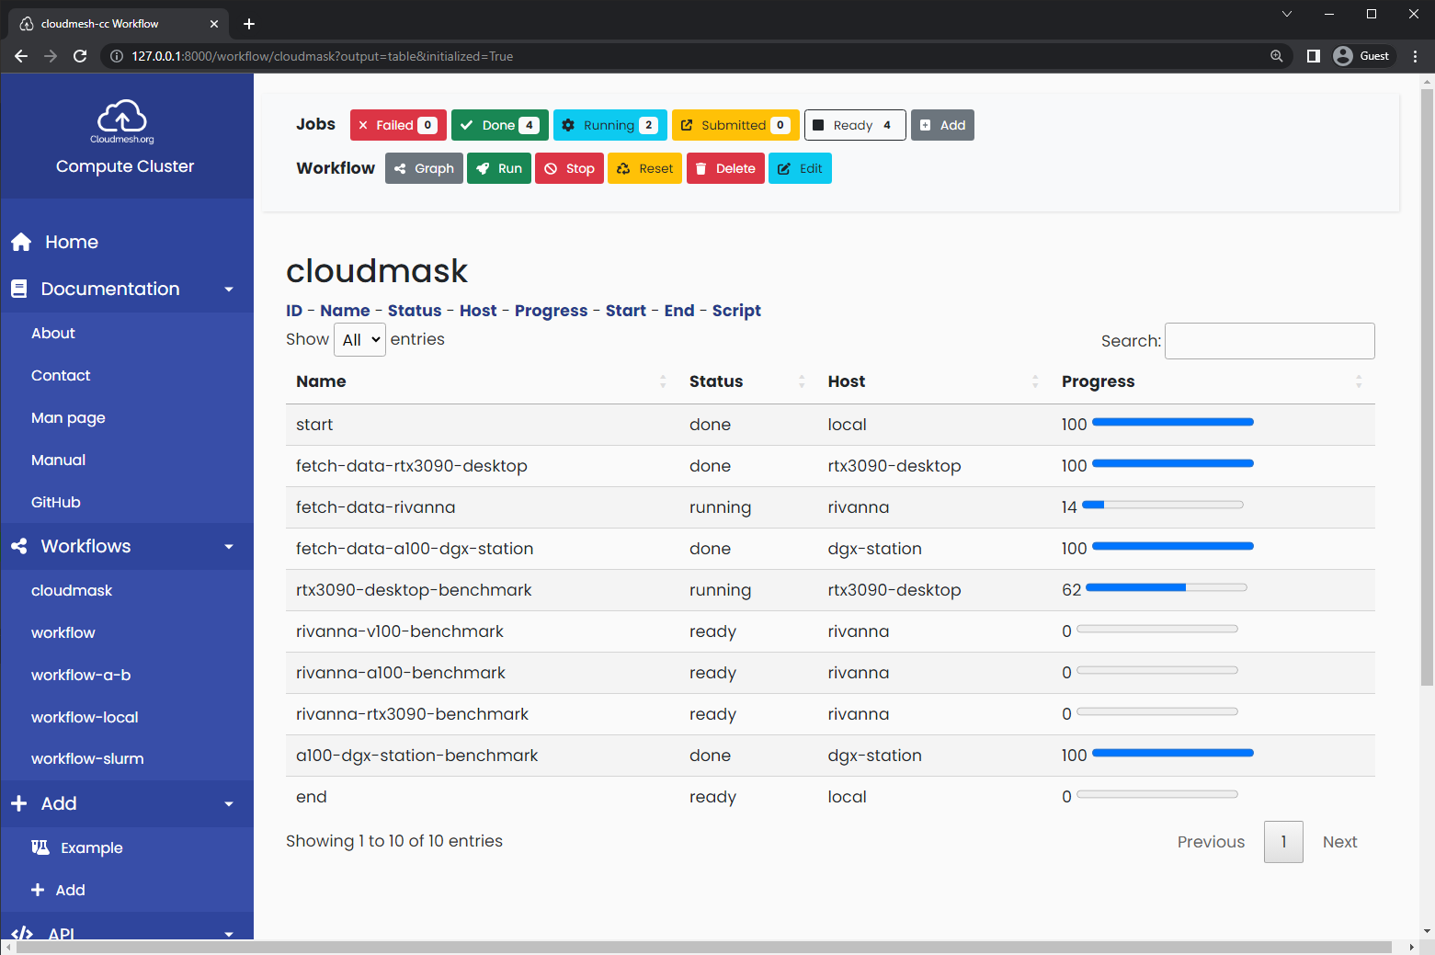
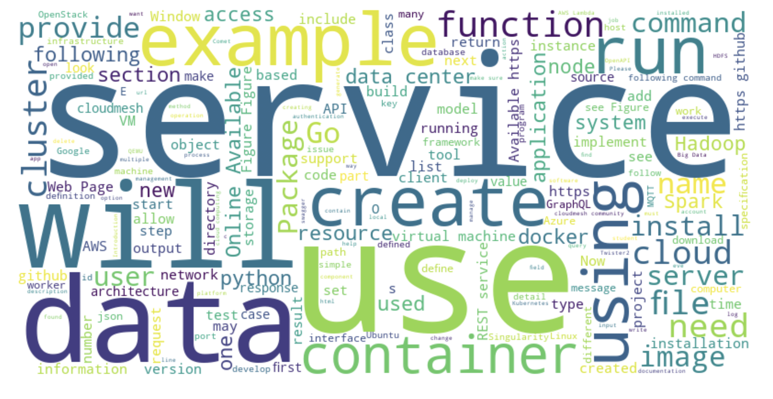
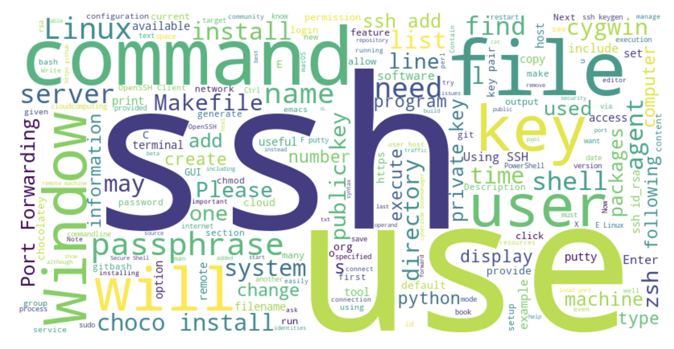
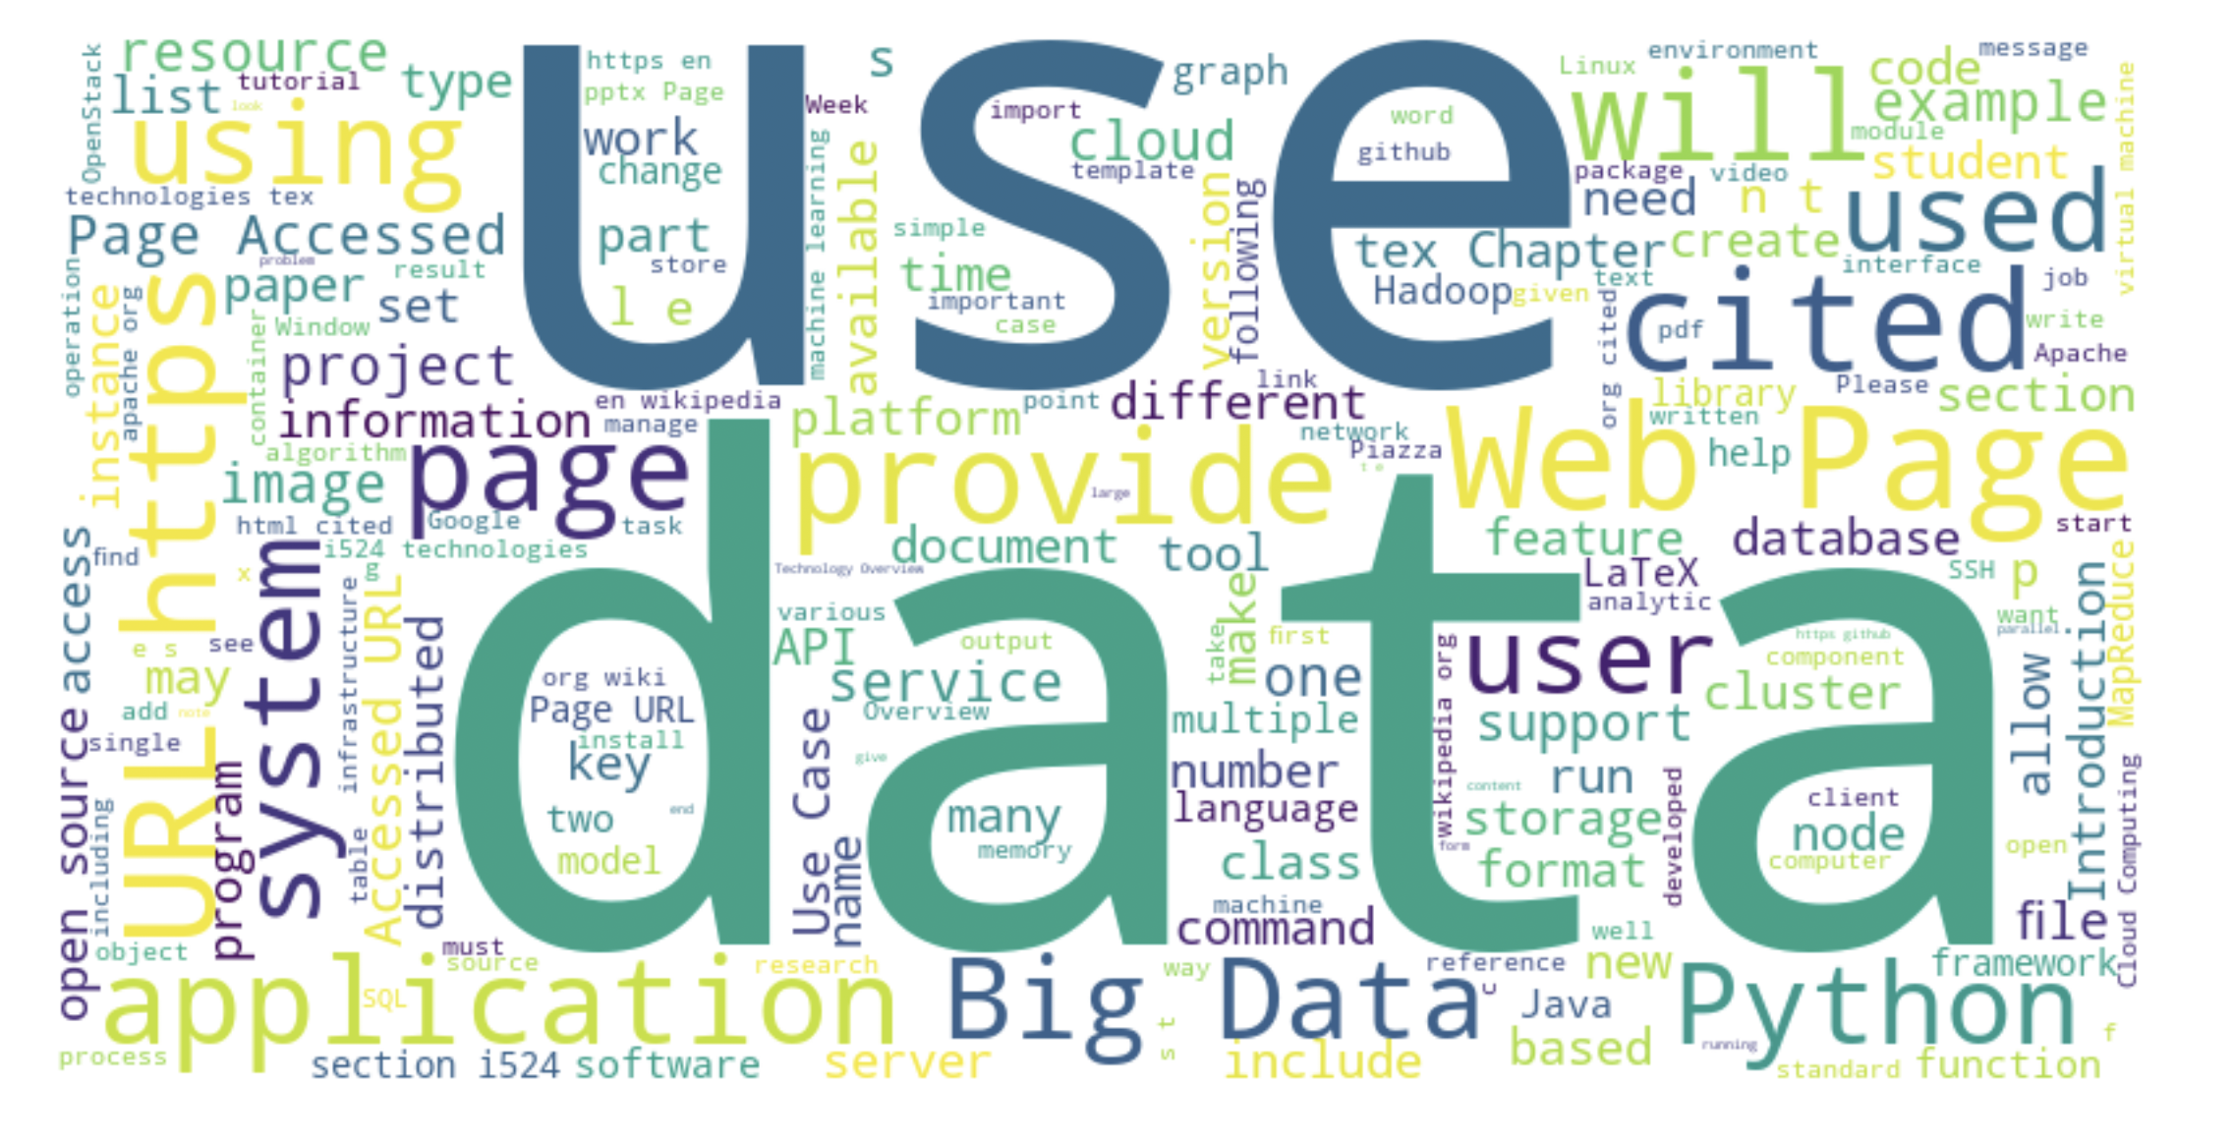
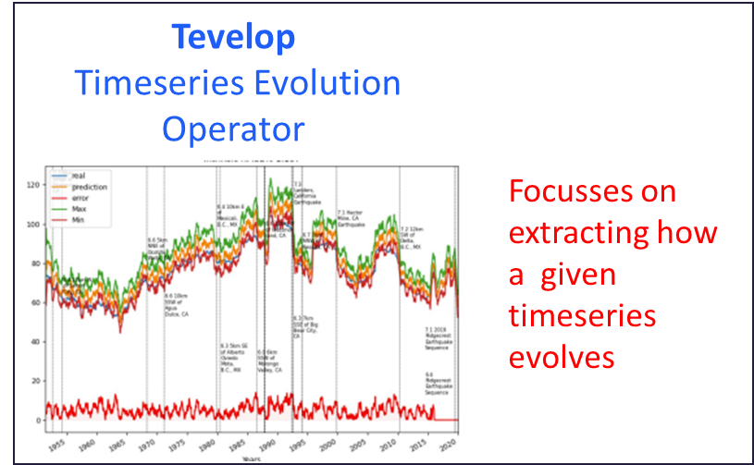

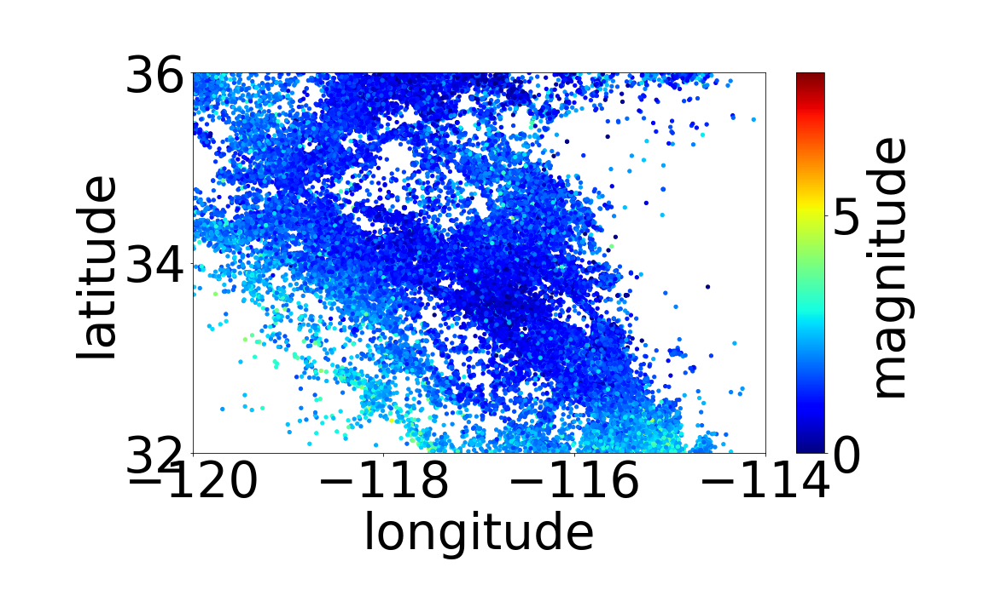



CyberTraining and Technologies for Students from Generation Z
AI for Science and Engineering
vxj6mb@virginia.edu
gregor@virginia.edu
NSF 2200409 (Virginia)
NSF 1829704 (Indiana)
Geoffrey C. Fox, Gregor von Laszewski
OVERVIEW
There exists a need for students to be familiar with cyberinfrastructure, Science applications, as well as artificial intelligence. Instead of learning all these concepts separately, it is important that a holistic approach is chosen that integrates these concepts. The outcome will be a well-educated workforce useful for research, government, and industry.
Due to the rapid change in any of the areas, it is important that the teaching material can and is updated regularly to address the newest developments.
We have implemented such an approach over several years and focused on particular subtopics to arrive at a state that allows us to teach AI for science.
Focused topics include:
•Introduction of Python for AI for Science
•Cloud Computing,
•HPC Computing,
•Big Data Applications and Analytics,
•Artificial Intelligence/Machine Learning.
We utilize open-source technologies such as GitHub to manage the growing
list of educational material. Teaching could be conducted in courses
but has been found most effective in research experiences.
Meetups and hackathons enhance these activities.
Material can be reused in other educational activities
as our contributions to nanoHub and FAMU REUs
demonstrated.
Participants are encouraged to
improve the content of the
material.
All material is publicly available
under Open-Source License.
Highlights
> 200 undergraduate applied Fall 22-Summer 23; > 50 applied Fall 2023
> 2000 pages educational material
> 170 repositories
Interaction of MLCommons applications
Significant technology development
Hybrid cloud computing interface
Benchmarking
GPU use
Experiment management
Compute resource coordination
Online and PDF material publication framework
Individually customizable training material selection and production
Integrated holistic approach
Selected References
G. von Laszewski, J.P. Fleischer, Geoffrey C. Fox, et.al. Templated Hybrid Reusable Computational Analytics Workflow Management with Cloudmesh, Applied to the Deep Learning MLCommons Cloudmask Application. In: eScience’23. Second Workshop on Reproducible Workflows, Data, and Security (ReWorDS 2022). Limassol, Cyprus, Oct. 2023.
G. von Laszewski, J.P. Fleischer, Robert Knuuti, Geoffrey. C. Fox, et.al. Opportunities for Enhancing MLCommons Efforts while leveraging Insights in High-Performance Big Data Systems Gained from Educational MLCommons Earthquake Benchmarks Efforts. submitted. Sept. 2023.
J. P. Fleischer, G. von Laszewski, et.al. Time Series Analysis of Cryptocurrency Prices Using Long Short-Term Memory. In: Algorithms 15.7 (2022). issn: 1999-4893. doi: 10.3390/a15070230. url: https://www.mdpi.com/1999-4893/15/7/230. https://github.com/cyberaide/paper-cloudmesh-cc-ieee-5-pages/blob/main/vonLaszewski- cloudmesh-cc.pdf.
G. von Laszewski, J. P. Fleischer, and Geoffrey C. Fox. Hybrid Reusable Computational Analytics Workflow Management with Cloudmesh. Tech. rep. arXiv, Oct. 2022. doi: 10.48550/ARXIV.2210.16941. url: https://arxiv.org/abs/2210.16941.
Gregor von Laszewski, Geoffrey C. Fox, at.al. Using GAS for Speedy Generation of HybridMulti-Cloud Auto Generated AI Services. In: IEEE COMPSAC 2021: Intelligent and Resilient Computing for a Collaborative World45th Anniversary Conference. Status = Added in NSF-PAR. All Virtual: IEEE, July 2021. url: https://laszewski.github.io/papers/vonLaszewski-openapi.pdf
Gregor von Laszewski and Geoffrey C. Fox. Proceedings of the CyberTraining REU2022 CyberTraining for Students and Technologies from Generation Z. Tech. rep. https://github.com/cloudmesh-community/pub/raw/master/docs/vonLaszewski-reu2022.pdf.
Gregor Laszewski,, Geoffrey C. Fox, et.al. Proceedings 2021 FAMU REU supported by Cybertraining-DSC. Online Books Digital Science Center. Bloomington, IN: Online, Indiana University, Aug. 2021. https://cybertraining-dsc.github.io/docs/pub/reu2021.pdf.
Cyberinfrastructure Training 90% CI 10% AI4Sci
CyberTraining for AI for Engineering and Science 50% CI 50% AI4Sci
AI for Science Training 10% CI 90% AI4Sci
Selected Technologies
Bookmanager to create custom collections of educational material from GitHub documents. https://github.com/cyberaide/bookmanager
Cloudmesh Experiment Executor to create AI Hyperparameter permutation experiments https://github.com/cloudmesh/cloudmesh-ee.
Cloudmesh StopWatch to simplify Benchmarking https://github.com/cloudmesh/cloudmesh-common
Cloudmesh GPU to simplify collection and display of GPU energy and temperature traces https://github.com/cloudmesh/cloudmesh-gpu [
Selected Web Sites
AI-First Engineering Cybertraining. https://cybertraining-dsc.github.io/docs/courses/ai-first Most recent new course in DSC Cybertraining with a focus on deep learning
Cloudmesh Code Repositories https://github.com/cloudmesh Repository for Cloudmesh code used in DSC Cybertraining
Cloudmesh Documentation https://cloudmesh.github.io Documentation for core technologies used in DSC Cybertraining
Cloudmesh Pi Cloud and Cluster Web Site https://cloudmesh.github.io/pi The Raspberry Pi component of DSC Cybertraining site
Cybertraining by the Digital Science Center https://cybertraining-dsc.github.io
The full Cybertraining cyberinfrastructure course material Summer 2021 Repository for REU Projects with FAMU https://cybertraining-dsc.github.io/docs/report/2021-reu/
DeepCAM Climate
Multi-modal Science Foundation Models
stemdl
Cosmoflow Universe
Candle-Uno Drug Discovery
MLCommons AI4Science
And HPC Benchmarks
2000 pages of material in the focus topics
MLCommons Cloudmasking Using Cloudmesh Experiment Execution
Cloudmesh
Compute
Coordinator
GNN Chemistry
Architecture
Openfold Protein Structure
MLCommons Earthquake using Tevelop
Impact of Hyperparameter
controlling inputs and outputs
Earthquake data
GPU Performance
Energy traces
Online Books
Cloud Computing
Introduction to Linux
Python for Cloud Computing
Handbook for Cloud Computing and Big Data
Customized book with bookmanager
Alok Choudhary, Geoffrey Fox, Tony Hey, Ed.,
Artificial Intelligence for Science: A Deep Learning Revolution.
BIOCOMPLEXITY INSTITUTE

